Slide 1


Slide 2





2025 NASCAR Key Performance Indicators
12 Sell-Outs in 2025, highlights include Coke 600, Pocono, Richmond, World Wide Technology in St. Louis, Talladega with Phoenix and Watkins Glen on multiple year sell-out streaks.
Huge successes…the addition of Prime Video, TNT/Discovery, and The CW as new television partners drew rave reviews from media and fans
The CW network coverage of the NASCAR Xfinity Series drew and average of 1 million viewers each week. The best viewership for that series since 2017.
New official partnerships from O’Reilly Auto Parts, Freeway Insurance, Anduril, Jose Cuervo, RAM, Suburban Propane, and other key partnerships.

Slide 3
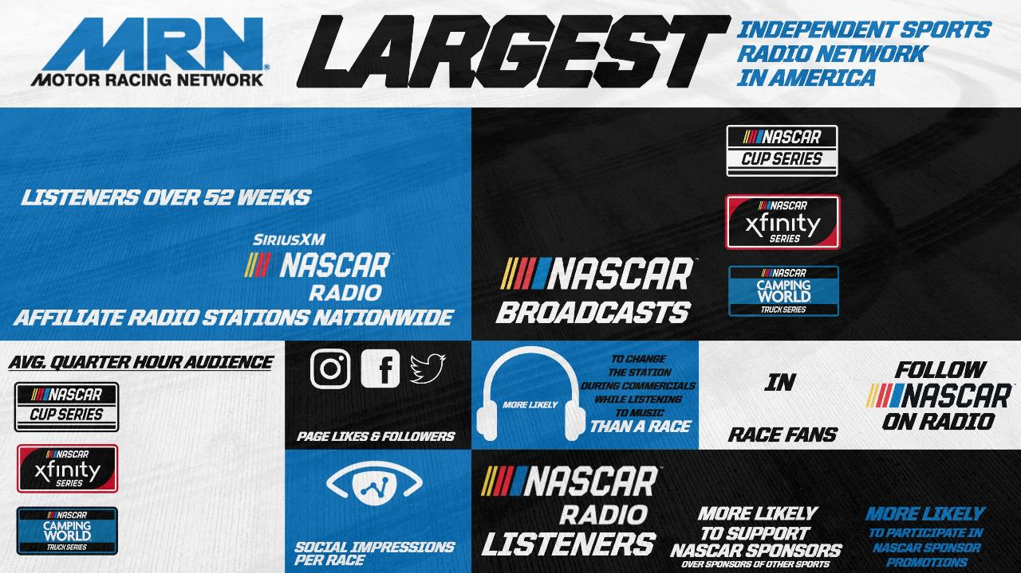



300 MILLION
68
24 RACES
19 RACES
Approximately 500
25 RACES
1
3
73%
4.8 MILLION
306,000 +
4.1 MILLION
26%
22%
3.1 MILLION
23.3 MILLION

Slide 4



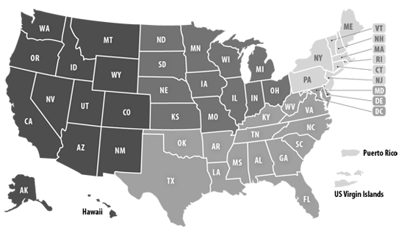






NASCAR Audio Listeners
Geographic Distribution
2
OUT OF
11%
5
2
5
$86,000
12%
30%
OUT
OF
62%
Male
38%
Female
Households
with Children
Average
Household Income
47%
18-44 Years Old
Nearly
Nearly
Top 5 NASCAR Markets
(by number of people interested in the sport)
Los Angeles
Indianapolis
Dallas
Washington, D.C.
Detroit
2
3
1
2
OUT
OF
OUT
OF
31%
Homeowners
Some College
or Beyond
Multicultural
Source: Nielsen Scarborough (USA+ Release 1, 2023). Field dates: December 2021 – May 2023. Sample size is approximately 1,230 NASCAR listeners.

Slide 5
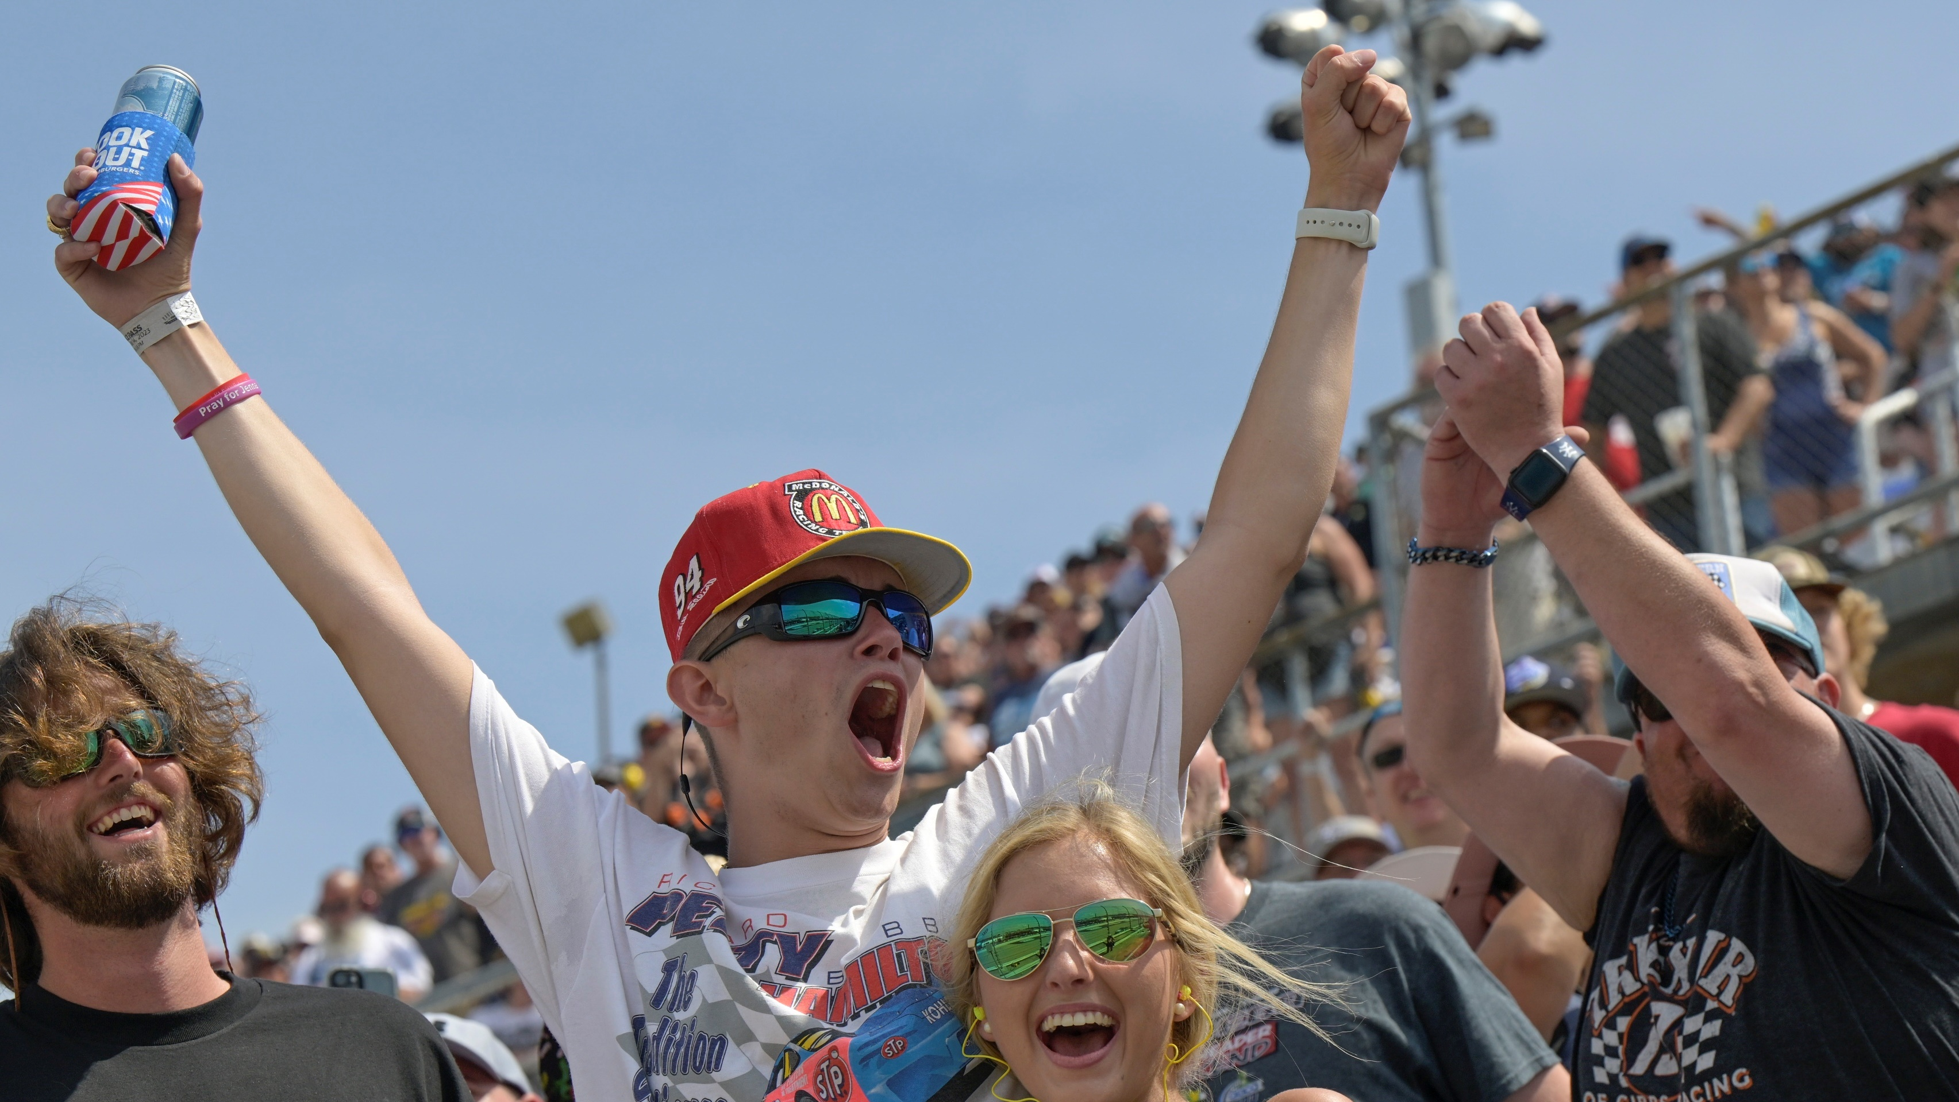


THE #1 SPORT
IN BRAND LOYALTY
(AMONG MAJOR US SPORTS)
NASCAR
IMPORTANT TO
BE AWARE
PGA
NHL
NBA
MLB
NFL
MORE LIKELY
TO TRY
MORE LIKELY TO
CONSCIOUSLY SUPPORT
MORE LIKELY TO
RECOMMEND
Q: Are you more or less likely to [INSERT LOYALTY METRIC] a product / service if that product / service is an official sponsor of [INSERT SPORT]? Source: MarketCast (formerly Turnkey Intelligence), results published in SBJ, n=400 for each sport’s entire study.Note: Data reflects latest results for each sports property as of February 2024
Notes:
Updated Feb 2024, adding PGA

Slide 6


Defeating Objections
Q:
Aren’t NASCAR fans just a bunch of Rednecks?
A:
Just over 23% of NASCAR fans earn over $75,000 annually with another 12% that earn over $100,000 a year. The average NASCAR fan has a household income of $86,000. That’s purchasing power!
Q:
Isn’t NASCAR a Southern sport?
A:
NASCAR has a national footprint. It’s fan base mirrors the population of the US where the largest percentage of population lives in the South (47%). 53% of NASCAR fans live outside the Southeast. Watkins Glen International which is closer to Canada than Charlotte celebrated its nineth consecutive sellout in 2024.
Q:
Don’t NASCAR fans watch the races on TV?
In 2026, only ten of thirty-eight races are scheduled to be broadcast Fox or NBC, the rest on satellite or cable only networks FS1, USA & TNT plus streamer Prime Video. It’s confusing week to week, even for a die-hard fan. Some fans may not even have those services. However, the races are in the same place every week on my station.
A:
Source: 2023 NASCAR Next Gen Fan Study – FMR Associates
2022 thedrivetoconnect.com/nascar-fan-dempgraphics/
Nielsen Scarborough (USA+ Release 1, 2021).

Slide 7
Defeating Objections
Q:
Where’s the value in a NASCAR fan for my business?
A:
Four of Forbes Top 10 Most Valuable Brands use NASCAR to market their products. One in four Fortune 500 companies in America also use NASCAR, making it the #1 sport in marketing participation. These companies spend millions on marketing to NASCAR fans.
Q:
Why would anyone listen to NASCAR on the radio?
A:
NASCAR fans bring their sport with them. 31% of all NASCAR fans claim they follow their sport on the radio. The season is 10 months long. Most people don’t have the time to set aside 4+ hours every week in front of the television. Almost half of at-home radio listeners to NASCAR are watching TV too, but with the sound turned down.
Q:
Aren’t all NASCAR fans men?
A:
Many NASCAR fans are men (62%), but NASCAR has the highest percentage of fans who are women, more than any other sport (38%).
Source: 2023 NASCAR Next Gen Fan Study – FMR Associates
Nielsen Scarborough (USA+ Release 1, 2021).
“REPUCOM to Closely Monitor Sponsorship Performance” REPUCOM.net March 2015
2022 thedrivetoconnect.com/nascar-fan-dempgraphics/

Slide 8
Defeating Objections
Q:
Aren’t NASCAR fans too old for my business?
A:
Almost 50% of all NASCAR fans are aged 25-54, the highest earning potential years of a person’s life and radio’s favorite demo.
Q:
Don’t people listen to radio during the week? NASCAR races are on the weekends.
A:
NASCAR fans bring their sport with them. 31% of all NASCAR fans claim they follow their sport on the radio. Nielsen recently released radio listening data that shows weekend listening in most demos mirrors listenership in afternoon drive .
Q:
Why should I advertise on your NASCAR broadcasts when none of my competitors are?
A:
If the demos of NASCAR match up and the idea aligns with your marketing plan, why wouldn’t you want a conduit to this loyal and sponsor friendly audience.
Source: American Marketing Assoc. 2023 NASCAR Next Gen Fan Study – FMR Associates
“REPUCOM to Closely Monitor Sponsorship Performance” REPUCOM.net March 2015
Nielsen report “Don’t Sleep on Weekends When Considering Radio Listening” Feb. 25, 2016

Slide 9





2026 MRN Live Race Broadcast Schedule
2/1 The Clash at Bowman Gray Stadium
2/12 The Duel
2/15 DAYTONA 500
3/8 Phoenix Raceway
3/22 Darlington Raceway
3/29 Martinsville Speedway
4/19 Kansas Speedway
4/26 Talladega Superspeedway
5/10 Watkins Glen International
5/17 All-Star Race (Dover Motor Speedway)
6/7 Michigan International Speedway
6/14 Pocono Raceway
6/21 Naval Base Coronado (San Diego)
7/5 Chicagoland Speedway
8/9 Iowa Speedway
8/15 Richmond Raceway
8/29 Daytona International Speedway
9/6 *Darlington Raceway
9/13 *World Wide Technology Raceway
9/27 *Kansas Speedway
10/18 *Phoenix Raceway
10/25 *Talladega Superspeedway
11/1 *Martinsville Speedway
11/8 *Homestead-Miami (Championship)
2/14 Daytona International Speedway
3/7 Phoenix Raceway
3/21 Darlington Raceway
3/28 Martinsville Speedway
4/4 Rockingham Speedway
4/18 Kansas Speedway
4/25 Talladega Superspeedway
5/9 Watkins Glen International
6/13 Pocono Raceway
6/20 Naval Base Coronado (San Diego)
7/4 Chicagoland Speedway
8/8 Iowa Speedway
8/28 Daytona International Speedway
9/5 Darlington Raceway
9/12 World Wide Technology Racewa
10/17 *Phoenix Raceway
10/24 *Talladega Superspeedway
10/31 *Martinsville Speedway
11/7 *Homestead-Miami (Championship)
2/13 Daytona International Speedway
2/21 EchoPark Speedway (Atlanta)
2/28 St. Petersburg, FL (with IndyCar)
3/20 Darlington Raceway
4/3 Rockingham Speedway
4/10 Bristol Motor Speedway
5/1 Texas Motor Speedway
5/8 Watkins Glen International
5/15 Dover Motor Speedway
5/22 Charlotte Motor Speedway
5/29 Nashville Superspeedway
6/6 Michigan International Speedway
6/19 Naval Base Coronado (San Diego)
7/11 Lime Rock Park
7/18 North Wilkesboro Speedway
7/24 Lucas Oil Raceway (Indianapolis)
8/14 Richmond Raceway
8/22 New Hampshire Motor Speedway
9/17 *Bristol Motor Speedway
9/26 *Kansas Speedway
10/3 *Charlotte Motor Speedway
10/16 *Phoenix Raceway
10/23 *Talladega Superspeedway
11/1 *Martinsville Speedway
11/6 *Homestead-Miami (Championship)
2/14 Daytona International Speedway
4/4 Rockingham Speedway
4/18 Kansas Speedway
4/25 Talladega Superspeedway
5/8 Watkins Glen International
6/5 Michigan International Speedway
6/12 Pocono Raceway
7/3 Chicagoland Speedway
7/10 Lime Rock Park
7/24 Lucas Oil Indianapolis Raceway Park
8/7 Iowa Speedway
9/25 Kansas Speedway
10/17 Phoenix Raceway
*Playoff Races

Slide 10




MRN ESSENTIAL PROGRAMMING
Devoted exclusively to NASCAR, this one-hour magazine show is hosted by Mike Bagley, Tuesday nights at 7:00 PM, and features in-depth NASCAR news and exclusive interviews with the stars of the sport (52 weeks)
Two-minute daily newscasts that air in morning and afternoon drive featuring the latest information from NASCAR including race results, driver insight, and breaking news (52 weeks)
Two-minute recap every Monday during the NASCAR season that gives highlights of the weekend’s events with driver audio and highlights from the winning teams (seasonal)

Slide 11
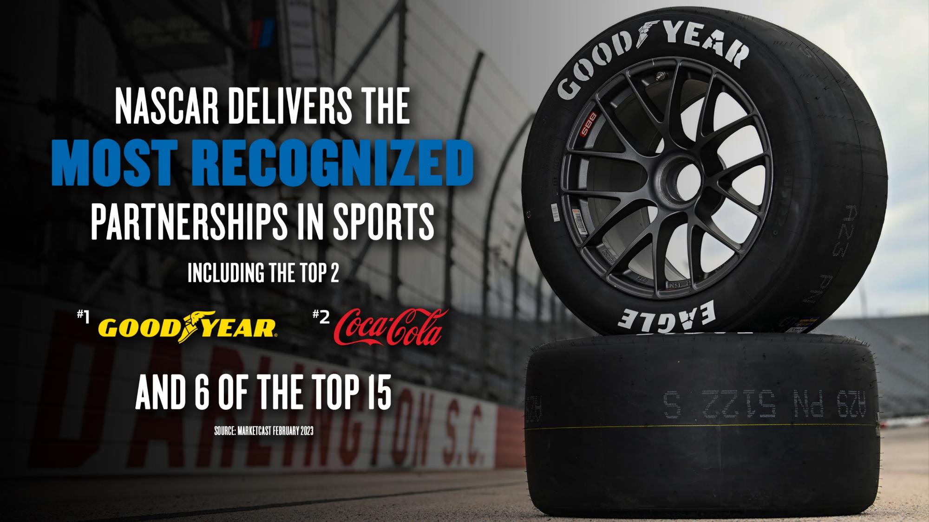

Slide 12

















2025 MRN PARTNERS

Slide 13














































NASCAR OFFICIAL
LEAGUE PARTNERS
PREMIER PARTNERS
Notes:
An exclusive council comprised of sales, marketing, procurement and executives from NASCAR Official Partners and Industry members.
Three times per year, NASCAR hosts focused business-to-business meetings to help create opportunities between NASCAR Official Partners
NASCAR Fuel For Business allows partners to:
>Connect with other companies on procurement opportunities
>Discover opportunity for co-marketing activities
>Maximize NASCAR investment by knowledge sharing with other partners
In between events, the NASCAR Partnership Marketing team works with each brand to make connections and create opportunities on a weekly basis.

Slide 14
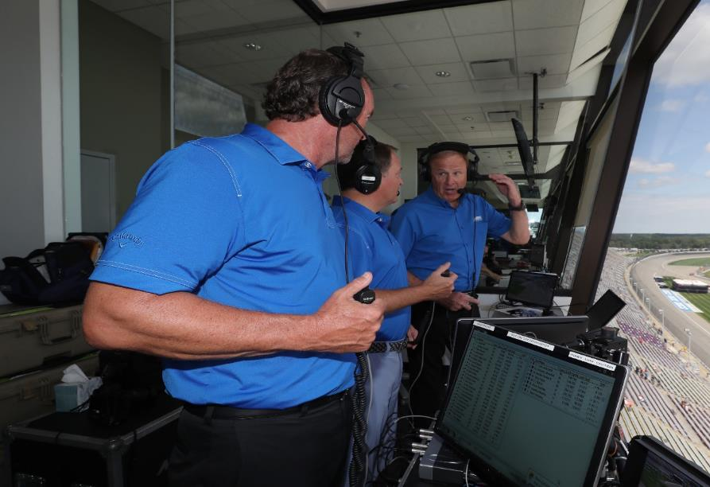
HOT PROSPECTS
NASCAR has always been a suburban and rural sport. There is a cultural difference between more metropolitan and more rural areas. The “Blue Collar” nature of the NASCAR fan bodes well for stations located outside major metropolitan areas and for clients catering to a “Blue Collar” lifestyle.
Automotive
  Auto Parts (new & used)
  Auto Body
  Auto Glass & Transmission Shops
Big Boy Toys
  Boats, ATVs & Motorcycles
  Snowmobiles & Personal Watercraft
Outdoors
  Hunting
  Fishing
  Camping
Home & Garden
  Lawn Equipment
  Compact Tractors
  Power Equipment
Home Improvement
  Paint Stores
Jewelry & Florists

Slide 15
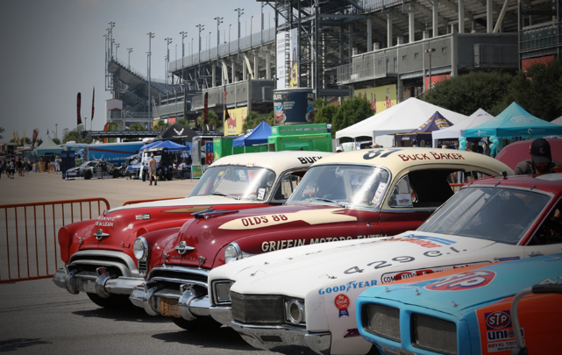
Legends Package (Limit 4)
Four (4) – thirty second (:30) commercials in each race broadcast
Weekly Hour-long sponsorship of race coverage with six (6) ten second (:10) sponsor billboards
Rotating schedule of sponsorship of NASCAR TODAY daily at 4:45pm
120 – thirty second (:30) commercials each month to air Mon-Sat 6am -7pm
Company Logo & website link on our NASCAR information web page
Sponsor mention included in four (4) weekly social media pushes
Included in forty (40) sixty second (:60) recorded promotional announcements and forty (40) “LIVE” promotional announcements each month
YOUR MONTHLY INVESTMENT: $3,000
(billed February – January)

Slide 16
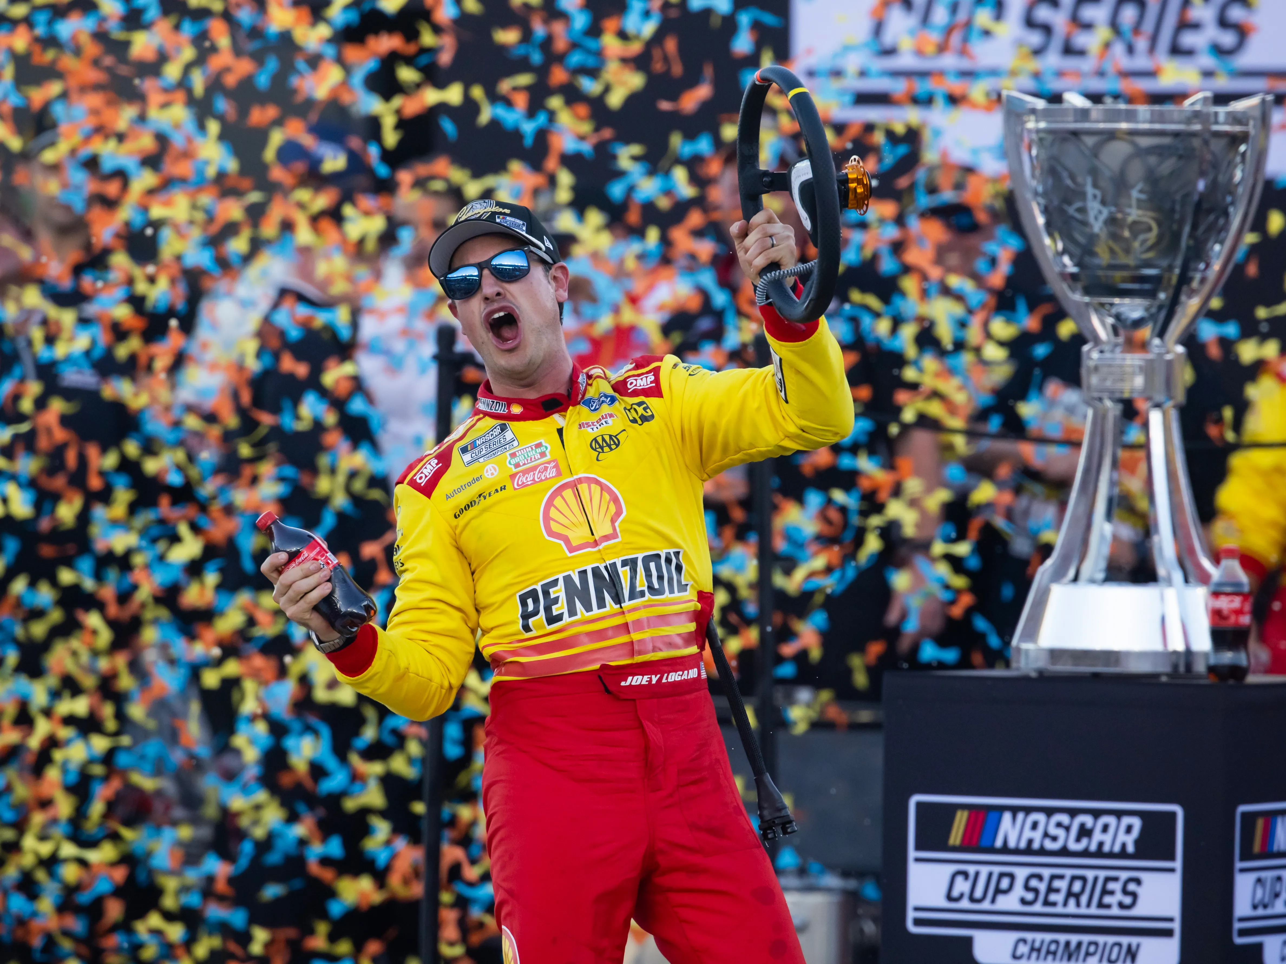
Champions Package (Limit 6)
Three (3) thirty second (:30) commercials per race
One (1) thirty second (:30) commercial each week in NASCAR LIVE
80 – thirty second (:30) commercials each month to air Mon-Sat 6am -12 Midnight
Company Logo & Link on our NASCAR web page
Included in sponsor rotation of numerous sixty second (:60) recorded & “LIVE” promotional announcements each month
YOUR MONTHLY INVESTMENT: $2,000
(billed February – January)

Slide 17
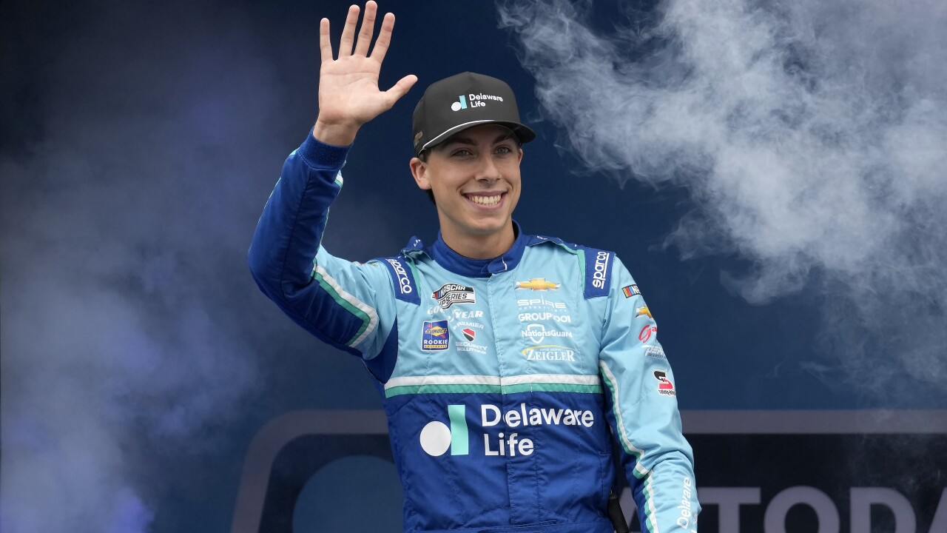
Rookie Package (Limit 8)
Two (2) – thirty second (:30) commercials in each race broadcast
40 – thirty second (:30) commercials each month to air Mon-Sat 6am – Midnight
Company Logo & Link on our NASCAR web page
Included in numerous “LIVE” promotional announcements each month
YOUR MONTHLY INVESTMENT: $1,000
(billed February – January)

Slide 18
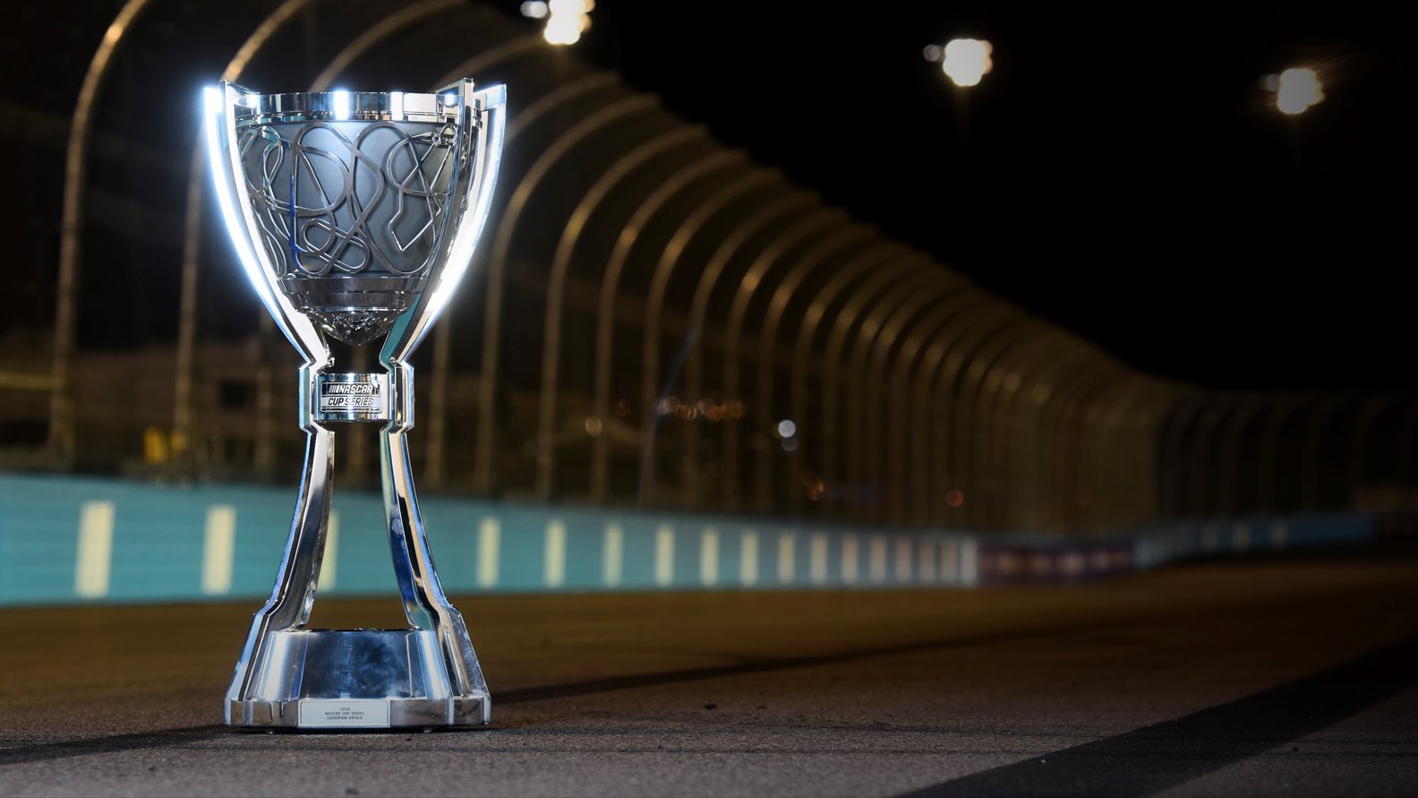

Bob Quick
bquick@mrn.com
704-262-6713
Notes:
Add brand logo beside NASCAR for Official Partner pitches only

