Slide 1


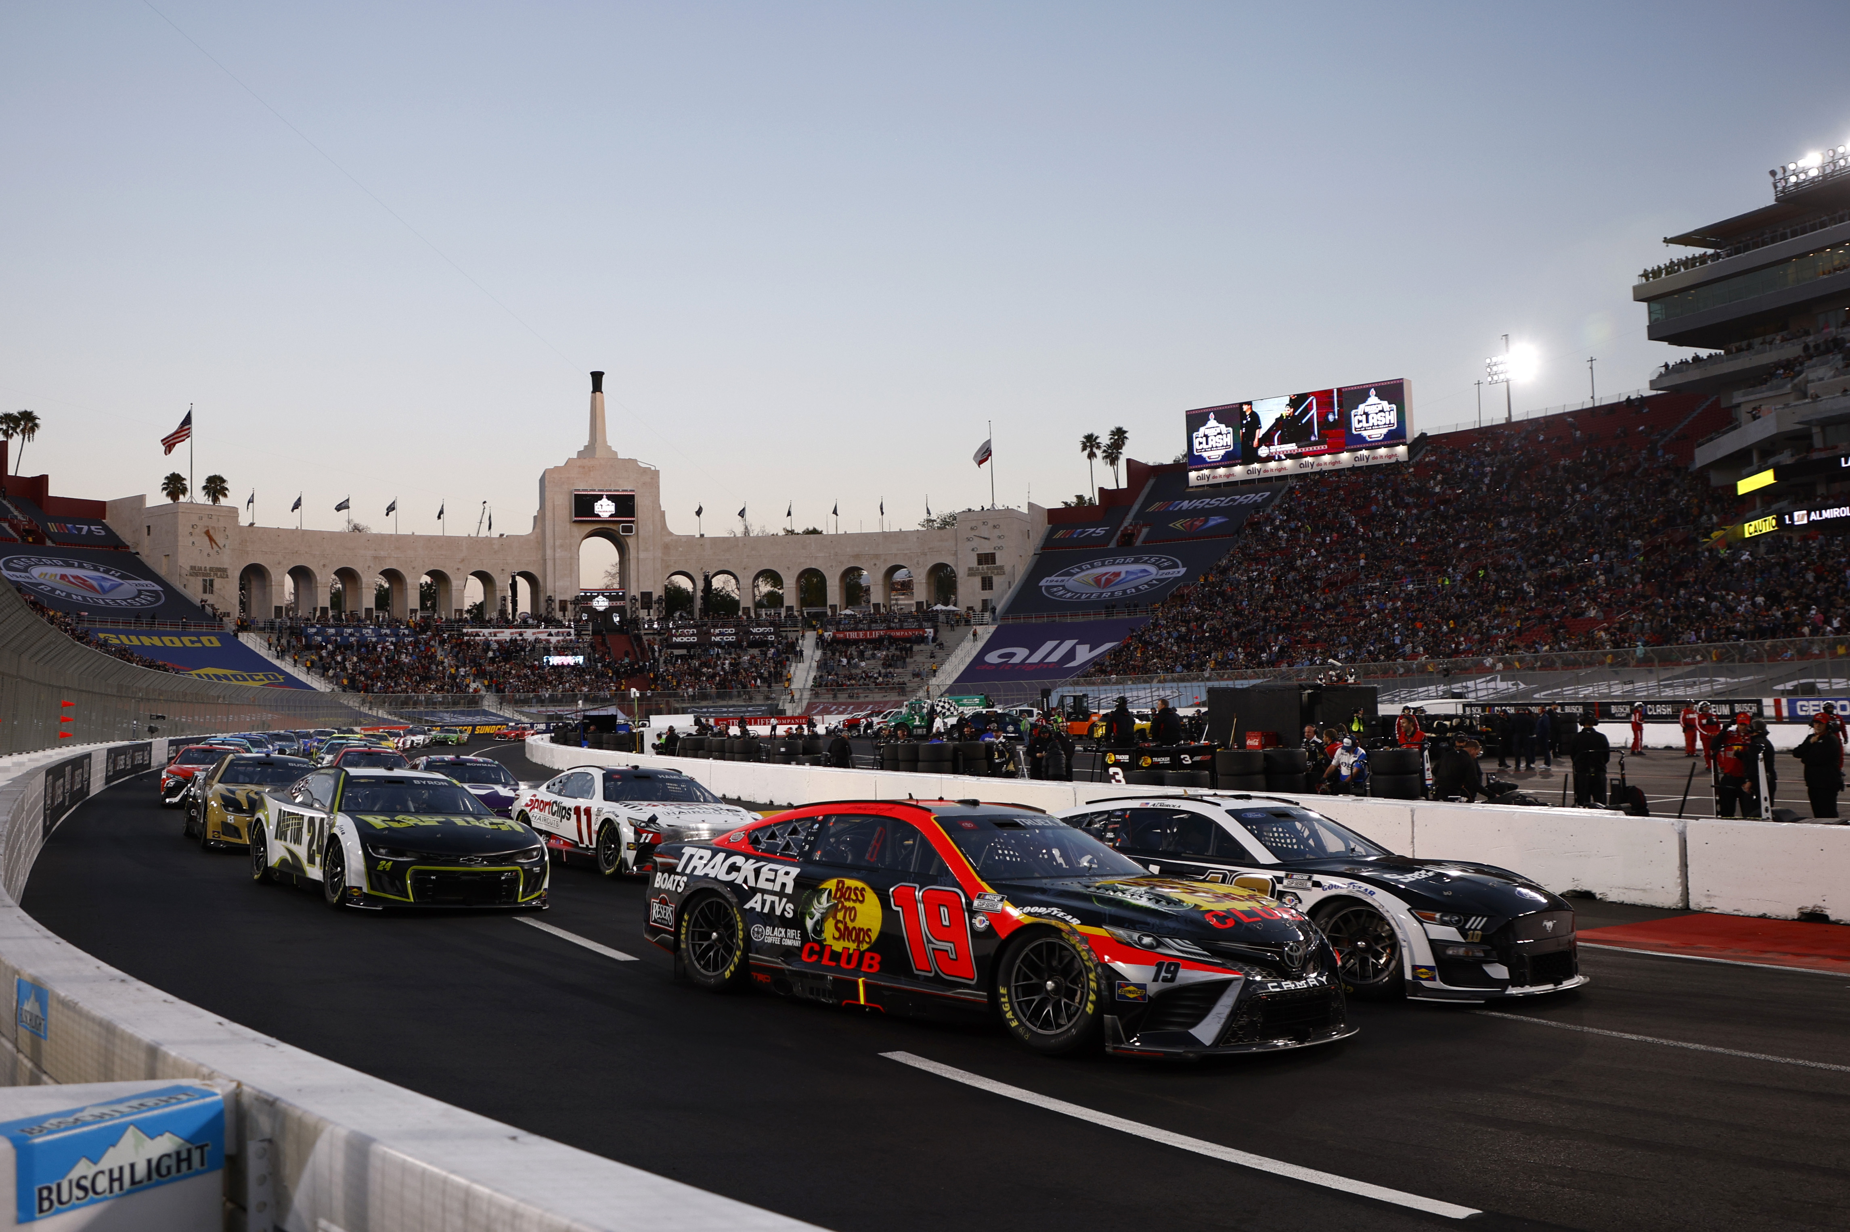

2023 Next Gen Fan Study

Slide 2
Agenda
1. Why this study
2. Appeal of NASCAR
3. NASCAR Fan Demographics
4. NASCAR Fan Consumer Behavior
5. Takeaways
2023 Next Gen Fan Study

Slide 3

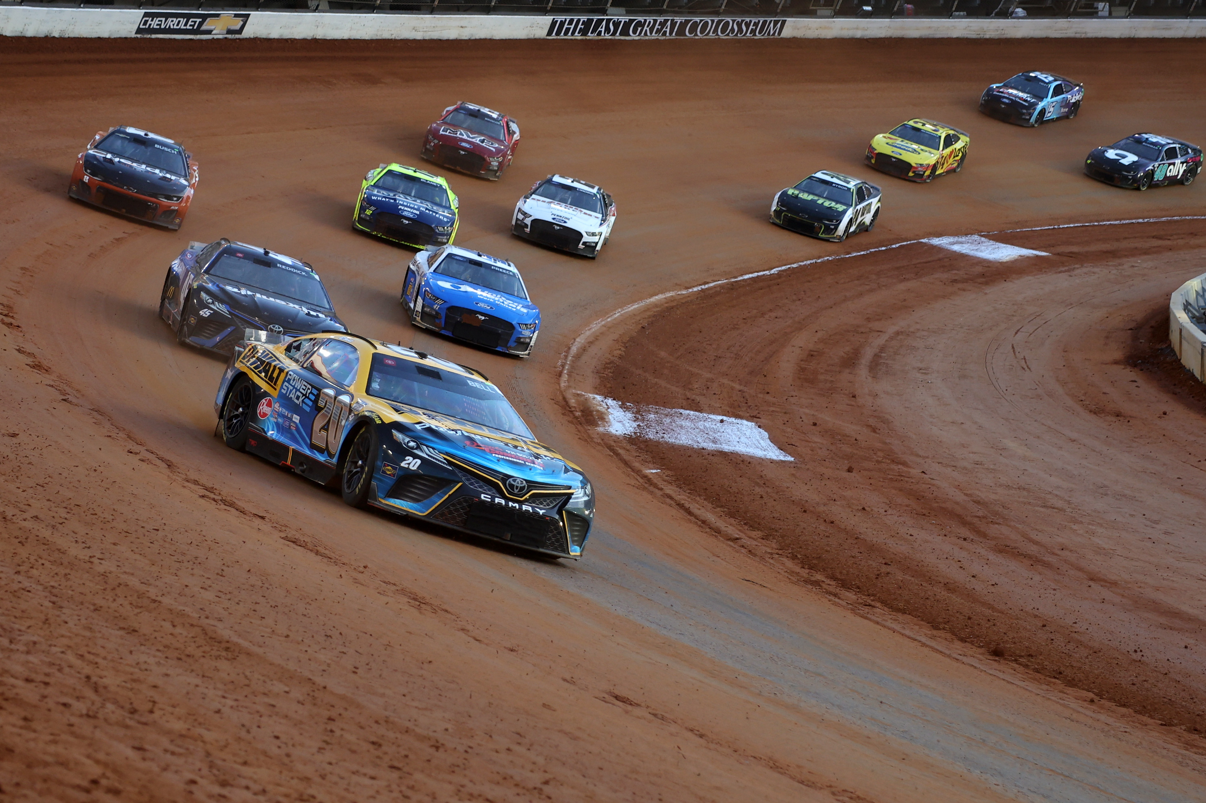
To supplement Nielsen/Scarborough
To look at the “fly over” markets, the other 120 DMAs not surveyed by Scarborough
To prospect markets (and similar markets) where we need partners
  Ashtabula, OH
  Bowling Green, KY
  Durant, OK
  Victoria, TX
  Vincennes, IN/IL
To put real data into current Motor Racing Network partner’s hands
1. Why this study
MRN Consumer Behavior Study, Spring 2023 – FMR Associates

Slide 4

% of 12+ Persons That Enjoy Motorsports
Motorsports Fan Highlights
 | Total 12+
Yes | 36.0%
No | 64.0%
 | Enjoy Motorsports
Enjoy NASCAR | 92.0%
Male | 70.4%
Female | 29.6%
2. Appeal of NASCAR
92% of
Motorsports fans are fans of
When you are talking about auto racing in the United States, you are talking about NASCAR
No other type of motorsport comes close
Heavy male interest like most sports
MRN Consumer Behavior Study, Spring 2023 – FMR Associates

Slide 5
% of Motorsports Fans in Various Demographic Categories
 | Enjoy Motorsports
25-54 | 49.3%
Income over $75K | 23.1%
Income over $100K | 12.0%
Married | 50.9%
Child Under 18 in Household | 44.4%
3. NASCAR Fan Demographics
Almost 51% of
fans are married
NASCAR fans outperform general population in percentage in radio’s favorite demo of 25-54 (49.3% vs. 37%)
NASCAR fans are more likely to be married than gen pop (50.9% vs. 45%)
Over 23% of NASCAR fans earn more than $75k with over half of those earning more than $100k
MRN Consumer Behavior Study, Spring 2023 – FMR Associates

Slide 6
Index of Motorsports Fans Consumer Behavior
Against Total Survey 12+ Population
 | Total 12+ |  | Enjoy Motorsports
New/Used car in next 6 months | 28.2% |  | 40.2%
New/Used truck in next 6 months | 19.0% |  | 30.7%
Outdoor sports/recreation equipment in next 6 months | 28.2% |  | 44.2%
Outdoor power tools/equipment for home/ work in next 6 months | 31.1% |  | 46.4%
Remodeling home in next 6 months | 24.8% |  | 32.0%
Financial services in next 6 months | 32.5% |  | 44.4%
Medical/health services in next 6 months | 61.4% |  | 67.8%
Major electronic items in next 6 months | 32.2% |  | 43.6%
New phone in next 6 months | 33.1% |  | 44.9%
Visiting a casino in next 6 months | 29.3% |  | 37.1%
Eat out at least once/week | 71.0% |  | 75.6%
Traveling in next year | 60.3% |  | 66.2%
Grocery shopper in home | 79.8% |  | 80.9%
Buying/renting new home in next year | 22.7% |  | 29.3%
Car repair/tires/batteries in next 6 months | 45.4% |  | 57.6%
Registered voter/plan to vote in next election | 67.0% |  | 70.2%
Purchase major household item in next 6 months | 39.5% |  | 48.0%
Active military/Reserve/Veteran | 6.9% |  | 10.7%
Trucking/construction/building/ground maintenance occupation | 9.2% |  | 13.3%
Used video/audio streaming services in past month | 85.8% |  | 90.2%
Enjoy listening to/watching Motorsports | 36.9% |  | 84.7%
4. NASCAR Consumer Behavior
fans over index on average 10.1%
MRN Consumer Behavior Study, Spring 2023 – FMR Associates

Slide 7
% of Motorsports Fans by Radio Format
 | Enjoy Motorsports
Sports | 61.3%
Rock/Classic Rock | 45.2%
Country | 43.1%
Classic Hits | 43.0%
News/Talk | 42.4%
Christian Contemporary/Gospel | 41.3%
Hispanic/Tejano | 40.1%
Total Population | 36.0%
Top 40 | 33.8%
Adult Contemporary | 33.0%
Adult Album Alternative | 18.7%
4. NASCAR Consumer Behavior (Continued)
61% of
sports format listeners are fans
We expected large percentages from Sports, Rock, & Country formatted radio stations
We didn’t expect that Christian Contemporary and Hispanic/Tejano formats would out index the general population
Even AC and Top 40 stations have a third of listeners interested in NASCAR
MRN Consumer Behavior Study, Spring 2023 – FMR Associates

Slide 8
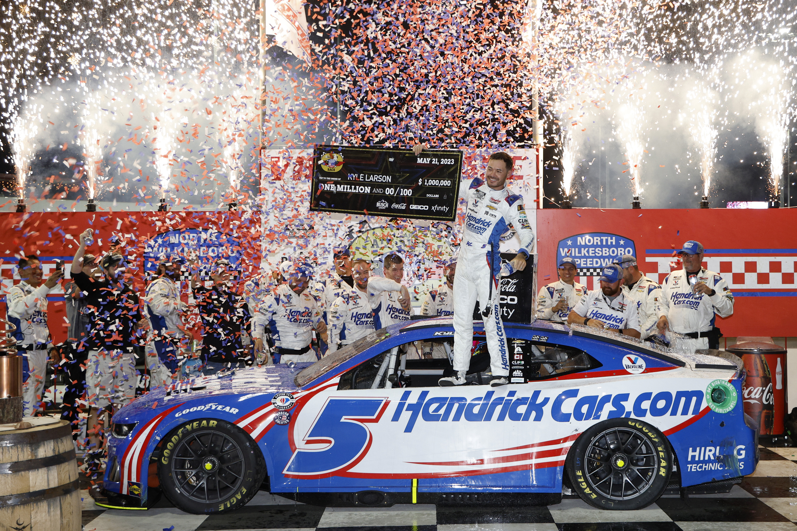
NASCAR fans are radio listeners with almost half in the 25-54 age group
NASCAR is far and away America’s Favorite form of Auto Racing
Over half of NASCAR fans are married and you can make all the same assumptions about them as you do your station’s listeners
NASCAR fans represent major spending power and over index gen pop as consumers of products and services
Almost every radio format has a large NASCAR fan base listening to it
5. Takeaways
MRN Consumer Behavior Study, Spring 2023 – FMR Associates

Slide 9
Make a plan now to sell the 2024 season in the September - November timeframe
If you are not cross promoting on all of your cluster stations, start now. There are NASCAR fans listening to all your stations.
If you are not promoting in other outside media, consider ways to do that, target places that might share audience with the top radio formats for NASCAR
Target new businesses in the consumer categories from page 6
Consider working with your local TV and cable system that carries NASCAR for promotional and sales opportunities. Have the TV sellers sell radio, and your sellers sell TV to clients that make sense.
Remember when it comes to auto racing in the U.S., nothing comes close to the size of the NASCAR fanbase
What Next?
92% of
Motorsports fans are fans of
MRN Consumer Behavior Study, Spring 2023 – FMR Associates

Slide 10
THANK YOU!
Bob Quick
bquick@mrn.com
704-262-6713
2023 Next Gen Fan Study

